Slide 1
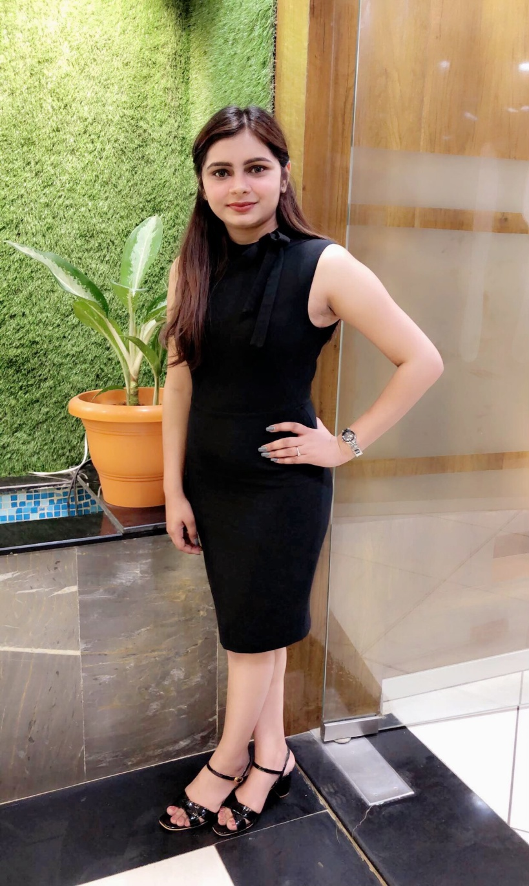
ECED 1018 – Foundations in early childhood education Instructions for Part 3 – Personal Ecology Bhoomi Panchal

Slide 2
Personal Characteristic:
TRUST- Trust is positive attitude about life for me. It is very important and difficult to gain someone’s trust and keep it forever in the field of early childhood education.
I believe, I am a trustworthy person. I always keep my promises and have a positive outlook about life. There were a times in my life, when everything was going wrong at that time, I still had a faith in myself that I can win over these circumstances. That is how my trust on myself helped me to come out from those difficult times.

Slide 3
As I worked with children before, I realized that parents trust care giver on the basis of how the care giver treats child, so I always tried my best to keep in touch with the parents about their child’s progress, because I believe that, effective and frequent combination with the parents is essential for trust building.
In my previous jobs as a caregiver, I always made sure that I treat the child like my own, so the child can feel the motherly love and connection. These is how a child starts to trusting the care giver.

Slide 4
RESPECT is an essential element of any relationship. I have always respected people at my work and in my personal life.
I always made sure that my words and my body language doesn’t hurt anyone’s feelings. Even if it does by mistake, I go and apologized. Because respect is a mutual thing, I will only get it if I give it first.

Slide 5
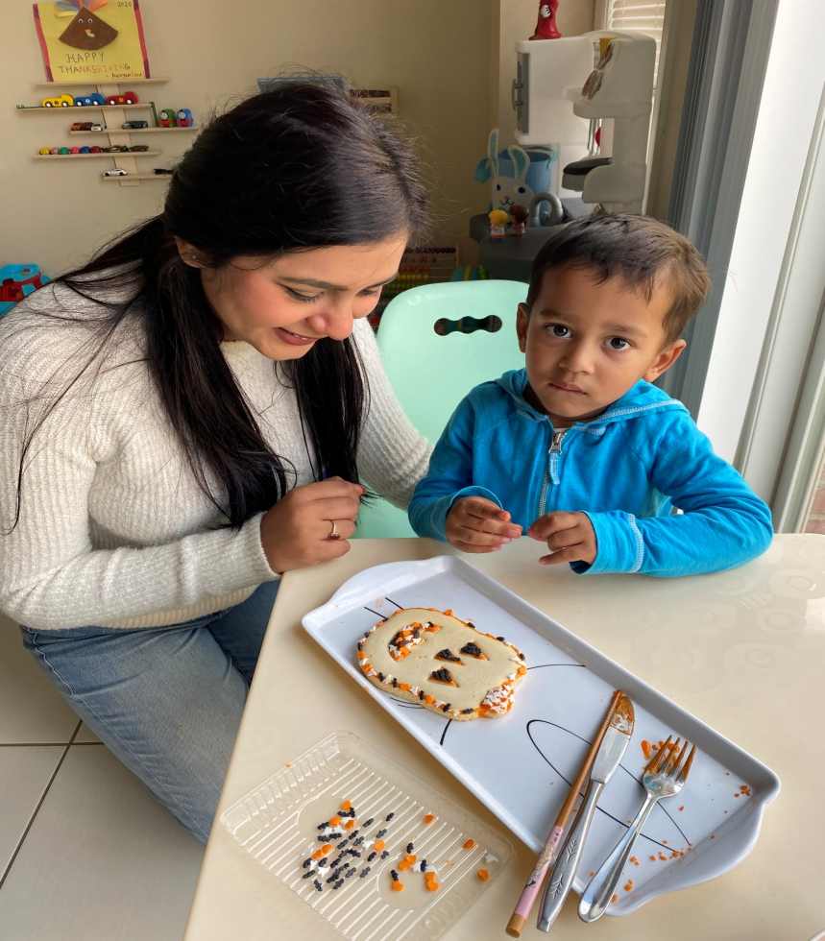
As a early childhood educator, respect place an important role. If you respect child’s ideas and thoughts only then they will learn how to respect others. I always try to listen to what the child wants to say and show me the work they do so that, they feel important and special.
Whenever the parents try to have conversation with me about their kids, I always listen patiently and make sure their ideas and suggestions are put to work.

Slide 6
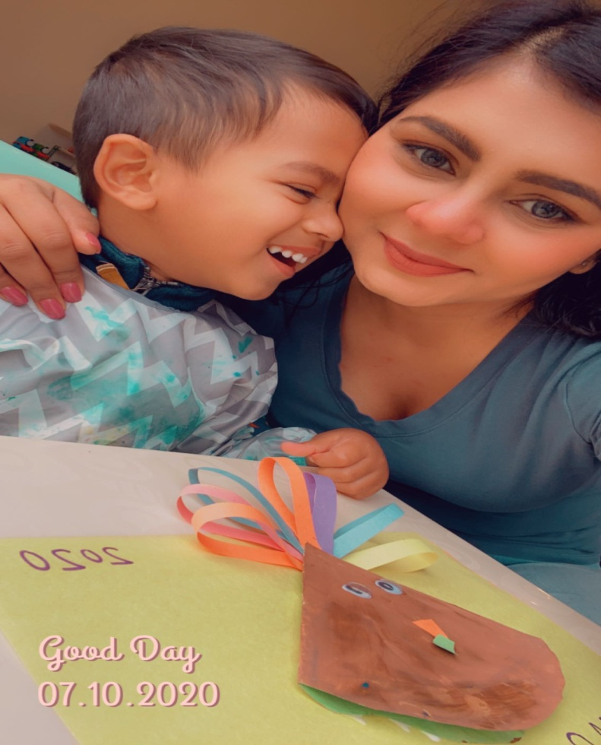
CARE is something that comes to me naturally. I tend to care about each and every person in my life. Whom I have met even for few days. For the persons who I love, I show my utmost care and concern by helping them whenever they need.

Slide 7
Care is the most important quality in an early childhood education, because that is what the parents expect and pay for. I have always made sure to ask a child how he/she is feeling many time throughout the day. If the child is not feeling ok, I try to dig deeper and make sure what is bothering him/her.

Slide 8
Foundations of learning
Well-being – Well-being is very important foundation that refers to the skills, child’s habit and also emotional state of mind which helps a child grow healthy and strong. Following are the ideas to ensure well-being.
Making sure that children are outside playing in the fresh air after the days work so that they can feel relaxed.
Forming a positive relationship is also very important to ensure well-being. Positive relationships help them to listen and learn from each other.

Slide 9
Sleep helps in mental and physical growth of a child. So it is very important to make a sleep schedule for the child.
Limiting the time children spend on the computers or ipads helps in making sure that children are not technology dependent. Technology is important but the usage should be regulated.

Slide 10
Engagement- Engagement is a state of being genuinely involved and interested in something.
Allowing the children to put forward their ideas is very important part of engagement.
In case of special child we have to make sure that their aren’t any unnecessary barriers which are stopping the child to be a part of the class.
Giving the child a choice is also important. This way child will develop decision making qualities.
We should also provide proper feedback like saying “good-job”, and “nice-work”, this way the child feels motivated to engage in class.

Slide 11
Conclusion
Part 3: Personal ecology: (Personal characteristics)
Trust - Trust is very important in building a positive relationship
Respect - Respect is crucial in maintaining a relationship with a child and family
Care - Care decides how long that relationship is going to last.

Slide 12
Foundations of learning
Well Being
It helps in maintaining the physical and mental health of a child. It is very important as the childhood is the period when the body and brain is still developing. So with the 4 ideas I mentioned, one can help ensure a child’s well being.
2. Engagement
Engaging in class activities is crucial part for building the child’s confidence. Following the ideas I mentioned I will help ensure that a child is fully engaged in my class.

Slide 13
References
Panchal, B. P. (2020). self pic [Image]. Bhoomi Panchal, Brampton, Canada.

